Slide 1


<Name: Tung Tran>
<Date: 2024-09-29>

Slide 2

Outline
Executive Summary
Introduction
Methodology
Results
Conclusion
Appendix

Slide 3
Executive Summary
Summary of methodologies
Data Collection
Data Wrangling
Exploratory Analysis (SQL & Matplotlib )
Interactive Analytics (Folium & Plotly dash)
Predictive Analysis (Classiffication techniques)
Summary of all results
This presentation summarizes the data collection, exploratory analysis and predictive analysis results associated with SpaceX Falcon 9 case study. The purpose of this presentation is to let readers understand how the data collected and cleansed, then some primary correlation of features will be inferred by corresponding data through charts and interactive analytics; finally, classiffication techniques used during the predictive analysis to train and test model.

Slide 4
Introduction
Project background and context
SpaceX advertises Falcon 9 rocket launches on its website with a cost of 62 million dollars; other providers cost upward of 165 million dollars each, much of the savings is because SpaceX can reuse the first stage. Therefore if we can determine if the first stage will land, we can determine the cost of a launch. This information can be used if an alternate company wants to bid against SpaceX for a rocket launch.
Problems you want to find answers
In this presentation, readers will be walked through on how the author predict if the Falcon 9 first stage will land successfully.

Slide 5

Section 1

Slide 6
Methodology
Executive Summary
Data collection methodology:
Request api and webscraping
Perform data wrangling
Convert outcomes into training labels (1 and 0)
Perform exploratory data analysis (EDA) using visualization and SQL
Perform interactive visual analytics using Folium and Plotly Dash
Perform predictive analysis using classification models
Using GridSearchCV to find the best estimator and parameter with several methods such as KNN, SVM, Logistic Regression, etc.

Slide 7
Data Collection
How data sets were collected.
Calling API
Webscraping from wikipedia
Data collection process use key phrases and flowcharts

Slide 8
Data Collection – SpaceX API
Github URL: https://github.com/Tung-depressedsuperman/IBM-DataScience_SpaceX-project/blob/main/jupyter-labs-spacex-data-collection-api.ipynb
Request API
Check status code
Decode the response contentas a json

Slide 9
Data Collection - Scraping
Github URL: https://github.com/Tung-depressedsuperman/IBM-DataScience_SpaceX-project/blob/main/jupyter-labs-webscraping.ipynb
Request HTML page from wiki page
Create BeautifulSoup object
Find necessary table
Extract headers
Create DataFrame by parsing the launch HTML tables

Slide 10
Data Wrangling
How data were processed
In the data set, there are several different cases where the booster did not land successfully. Sometimes a landing was attempted but failed due to an accident. Therefore, we will mainly convert those outcomes into Training Labels with 1 means the booster successfully landed, and 0 means it was unsuccessful.
GitHub URL: https://github.com/Tung-depressedsuperman/IBM-DataScience_SpaceX-project/blob/main/labs-jupyter-spacex-Data%20wrangling.ipynb
Count values of the outcome column
Group bad and good outcomes into 2 different groups
Create outcome label (0 & 1) from outcome column

Slide 11
EDA with Data Visualization
Charts were plotted and why used those charts
Scatter plot. In order to understand the relationships of 2 or more features.
Bar chart. In order to compare the success rate of different orbit type.
Line chart. In order to know the launch success yearly trend over period of time.
GitHub URL: https://github.com/Tung-depressedsuperman/IBM-DataScience_SpaceX-project/blob/main/edadataviz.ipynb

Slide 12
EDA with SQL
The SQL queries performed
select distinct Launch_Site from SPACEXTBL
select * from SPACEXTBL where Launch_Site like 'CCA%' limit 5
select sum(PAYLOAD_MASS__KG_) from SPACEXTBL where Customer == 'NASA (CRS)'
select avg(PAYLOAD_MASS__KG_) from SPACEXTBL where Booster_Version == 'F9 v1.1'
select min(Date) from SPACEXTBL where Landing_Outcome == 'Success (ground pad)'
select Booster_Version, PAYLOAD_MASS__KG_, Landing_Outcome from SPACEXTBL where Landing_Outcome == 'Success (drone ship)' and PAYLOAD_MASS__KG_ between 4001 and 5999
select Landing_Outcome, count(*) from SPACEXTBL where Landing_Outcome like 'Success%' or Landing_Outcome like 'Failure%' group by Landing_Outcome
select Booster_Version, PAYLOAD_MASS__KG_ from SPACEXTBL where PAYLOAD_MASS__KG_ = (select max(PAYLOAD_MASS__KG_) from SPACEXTBL)
select substr(Date,6,2) as 'Month', Date, Booster_Version, Landing_Outcome, Launch_Site from SPACEXTBL where Landing_Outcome == 'Failure (drone ship)' and substr(Date,1,4) == '2015'
select Landing_Outcome, count(*) as Total_outcome from SPACEXTBL where Landing_Outcome == 'Success (ground pad)' or Landing_Outcome like 'Failure (drone ship)' and Date between '2010-06-04' and '2017-03-20' group by Landing_Outcome order by Total_outcome desc
GitHub URL: https://github.com/Tung-depressedsuperman/IBM-DataScience_SpaceX-project/blob/main/jupyter-labs-eda-sql-coursera_sqllite.ipynb

Slide 13
Build an Interactive Map with Folium
Map objects are created and added to a folium map
Circle. To add a highlighted circle area.
Marker. To mark on specific location with text label
MarkerCluster. To group all the markers which point to the same location into one cluster.
PolyLine. To draw a line beween 2 locations.
GitHub URL: https://github.com/Tung-depressedsuperman/IBM-DataScience_SpaceX-project/blob/main/lab_jupyter_launch_site_location.ipynb

Slide 14
Build a Dashboard with Plotly Dash
Plots/graphs and interactions have been added to a dashboard
Pie chart. To compare the success percentages of all sites.
Scatter chart. To understand the correlation between Payload and Class.
GitHub URL: https://github.com/Tung-depressedsuperman/IBM-DataScience_SpaceX-project/blob/main/spacex_dash_app.py

Slide 15
Predictive Analysis (Classification)
GitHub URL: https://github.com/Tung-depressedsuperman/IBM-DataScience_SpaceX-project/blob/main/SpaceX_Machine%20Learning%20Prediction_Part_5.ipynb
Create numpy array from column ‘Class’
Standardize the data
Split the data into train, test data
Create GridSearchCV object
Create Logistic Regression, SVM, DecisionTreeClassifier, KNN object
Fit the training data with different parameters
Calculate the score of the best estimator for each method
Draw the confusion matrix
Compare all scores of all methods

Slide 16
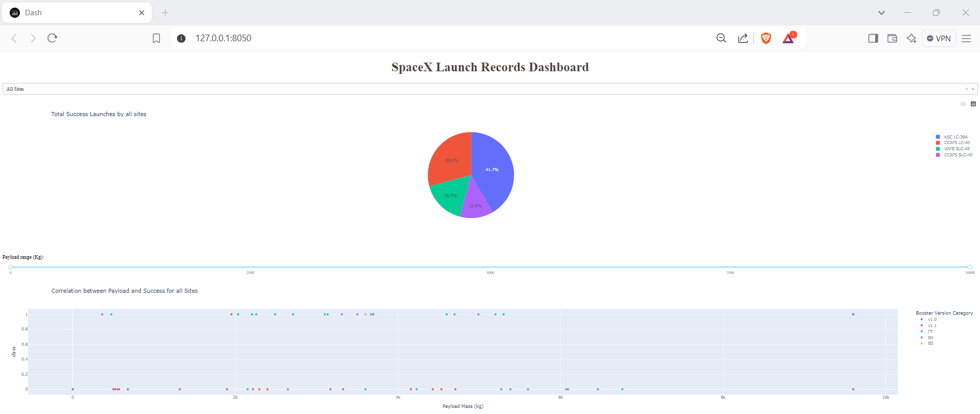
Results
Predictive analysis results: Logistic Regression and Decision Tree Classifier provide the best score.
Exploratory data analysis results

Slide 17

Section 2

Slide 18
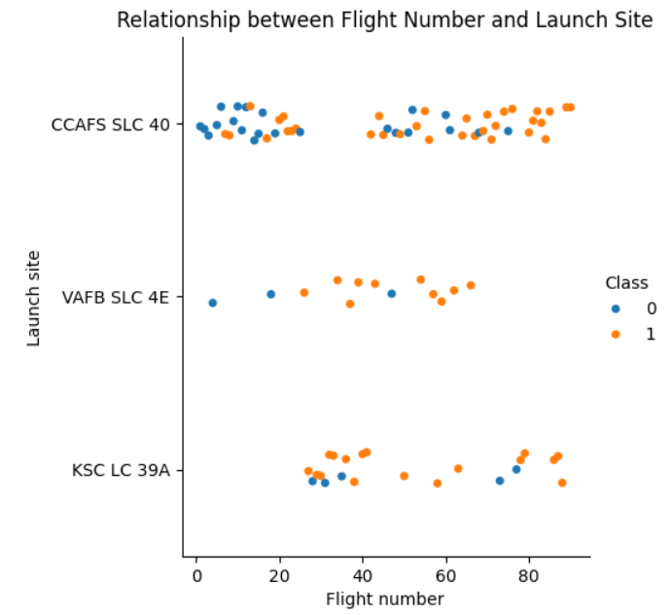
Flight Number vs. Launch Site
Scatter plot of Flight Number vs. Launch Site
Overall, the more rockets were launched at site VAFB SLC 4E and KSC LC 39A, the more successful the flight gained.
The above result is not totally correct with site CCAFS SLC 40. There are still unsuccessful flight, when flying more rockets at this site.

Slide 19
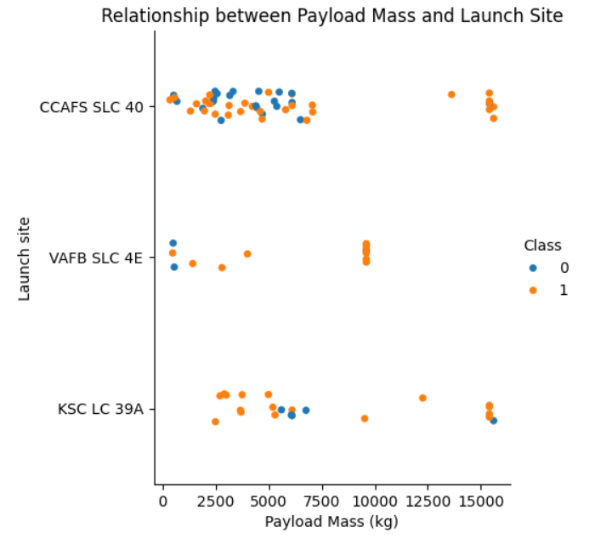
Payload vs. Launch Site
Scatter plot of Payload vs. Launch Site
When the payload mass was getting heavier, the successful flight was getting more often at CCAFS SLC40 and VAFB SLC 4E sites.
Although the successful rate also got higher while payload getting heavier at KSC LC 39A, a few of unsuccessful flights occurred.

Slide 20
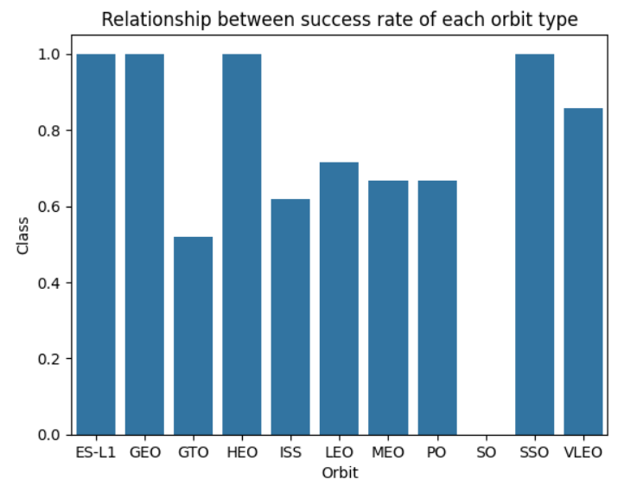
Success Rate vs. Orbit Type
Bar chart for the success rate of each orbit type
ES-L1, GEO, HEO, SSO and VLEO had the successful rate quite high
The rest stayed stably at around 0.6
The orbit type SO is the only one got none successful flight.

Slide 21
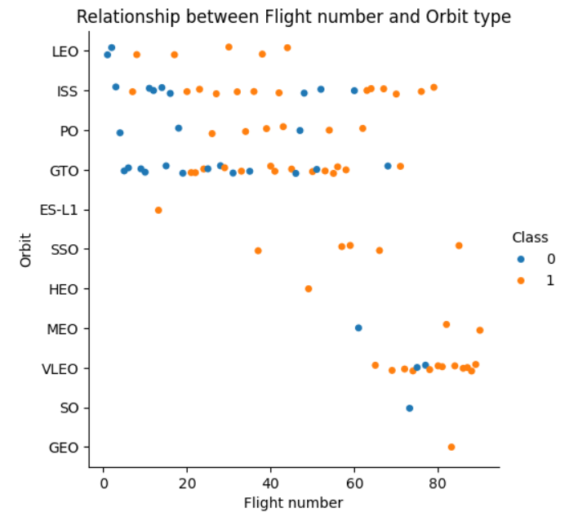
Flight Number vs. Orbit Type
Scatter point of Flight number vs. Orbit type
For LEO, ISS and VLEO orbit types, the more flight were launched, the more successful rate got.
Although the success rate of HEO, ES-L1 and GEO got maximum 1, number of flight were launched not much. Just only 1 flight was launched for each orbit.

Slide 22
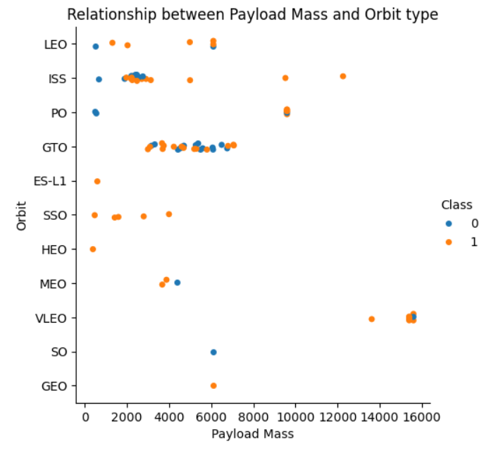
Payload vs. Orbit Type
Scatter point of payload vs. orbit type
Overall, the relationship between payload mass and orbit type is not very clear.
For most of the orbit types, the number of successful and unsuccessful flights were recorded quite the same.

Slide 23
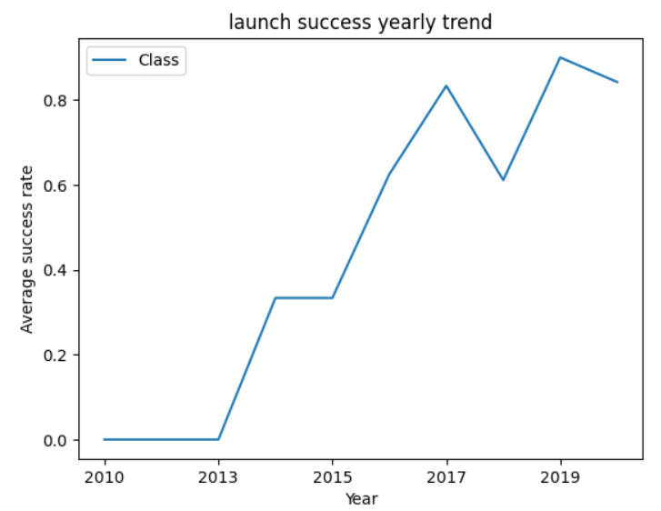
Launch Success Yearly Trend
Line chart of yearly average success rate
Overall, the launch success rate increased significantly since 2013.
There was a small drop in 2018. And after that, the rate raised up fast.

Slide 24
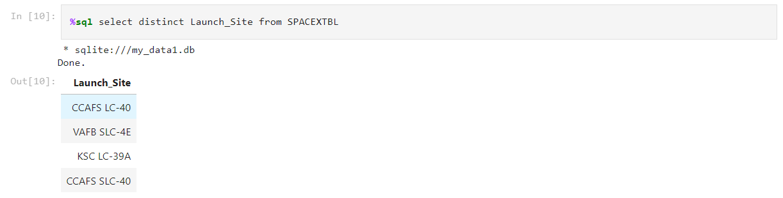
All Launch Site Names
There are 4 unique launch sites in total

Slide 25
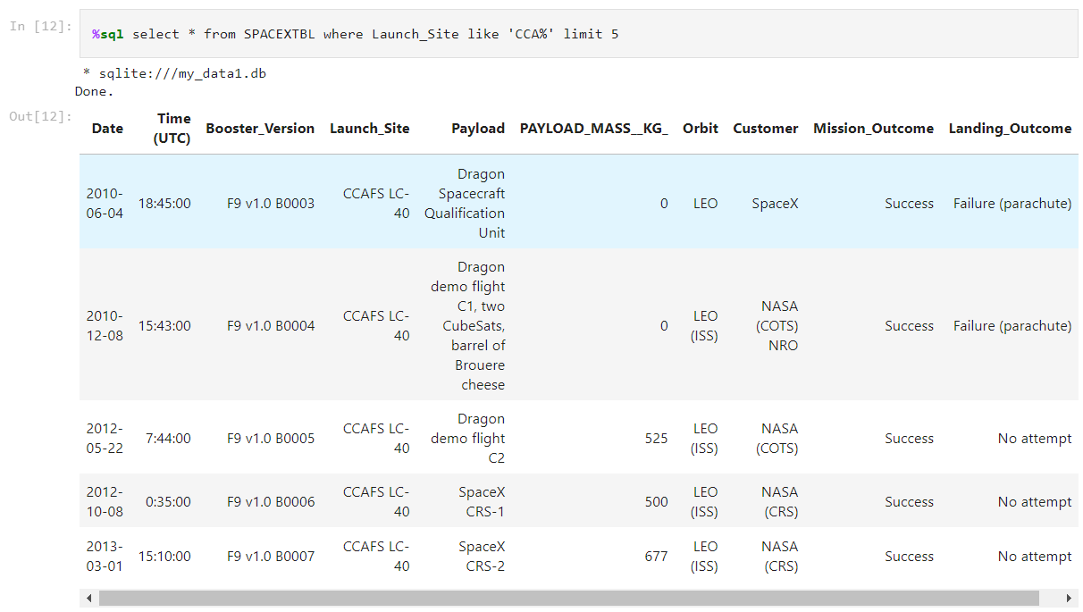
Launch Site Names Begin with 'CCA'
5 records where launch sites begin with `CCA`

Slide 26
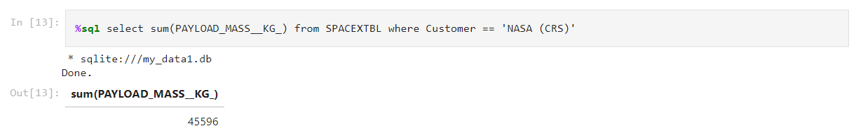
Total Payload Mass
The total payload carried by boosters from NASA (CRS) is 45596 kg

Slide 27
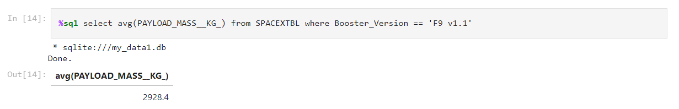
Average Payload Mass by F9 v1.1
The average payload mass carried by booster version F9 v1.1 is 2928.40 kg

Slide 28
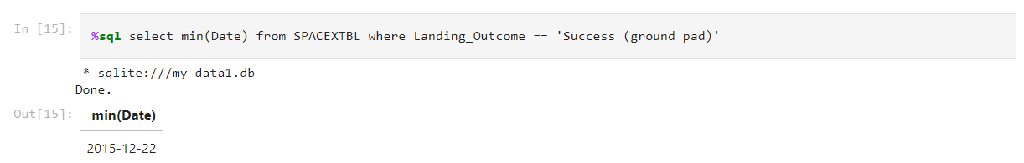
First Successful Ground Landing Date
The first successful date of landing outcome on ground pad is 2015-12-22

Slide 29
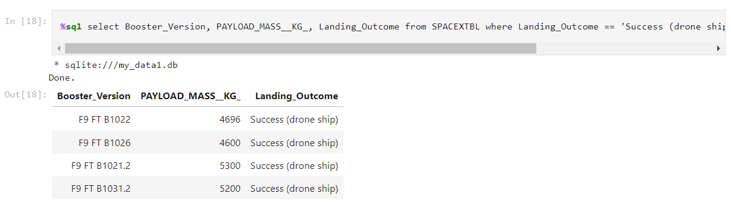
Successful Drone Ship Landing with Payload between 4000 and 6000
Below figure lists the names of boosters which have successfully landed on drone ship and had payload mass greater than 4000 but less than 6000

Slide 30
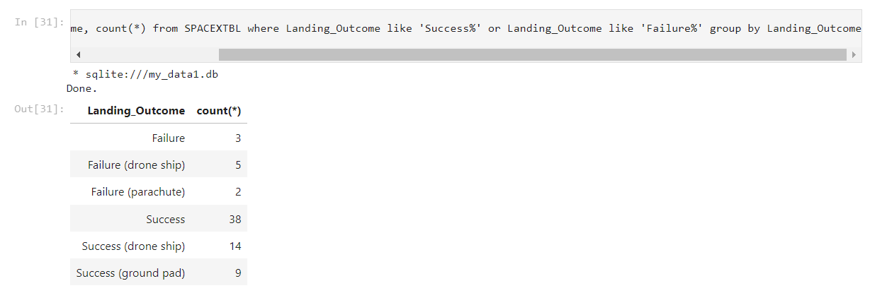
Total Number of Successful and Failure Mission Outcomes
The total number of successful and failure mission outcomes are listed in the figure below

Slide 31
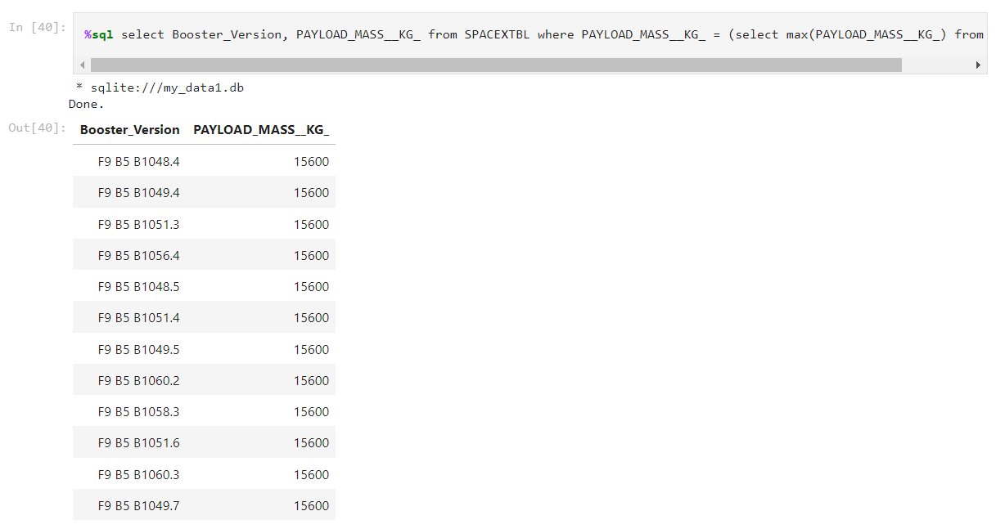
Boosters Carried Maximum Payload
Below figure list the names of the booster that have carried the maximum payload mass which is 15600 kg

Slide 32
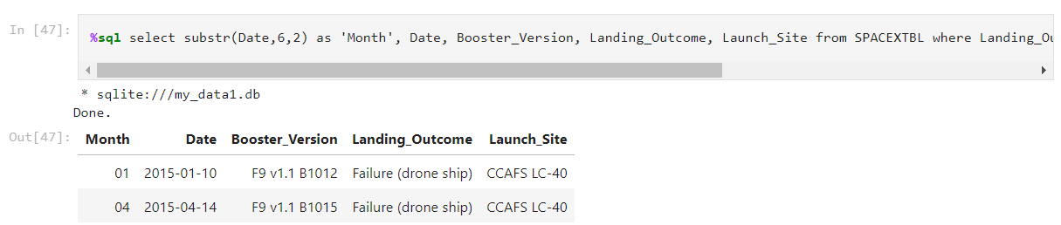
2015 Launch Records
There are 2 failed landing_outcomes in drone ship, their booster versions, and launch site names for in year 2015

Slide 33
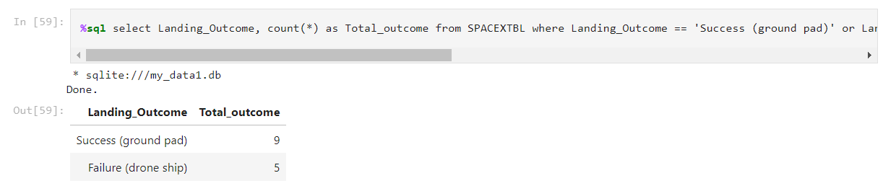
Rank Landing Outcomes Between 2010-06-04 and 2017-03-20
There are 5 Failure (drone ship) and 9 Success (ground pad) landing outcomes between the date 2010-06-04 and 2017-03-20, in descending order

Slide 34

Section 3

Slide 35
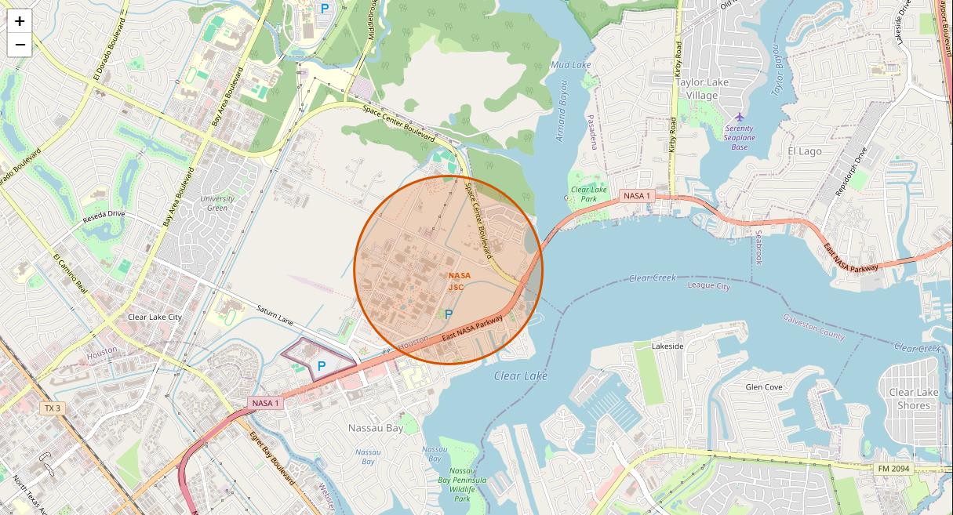
<NASA Johnson Space Center>
The center is close to the coastal side.

Slide 36
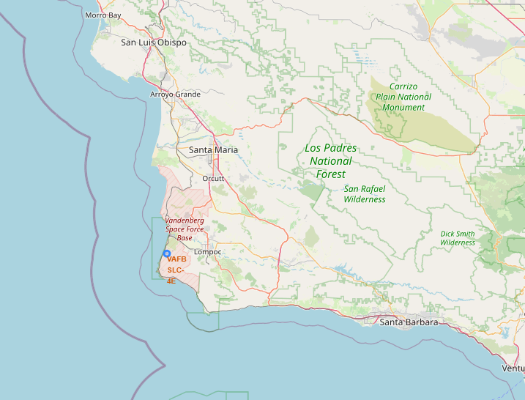
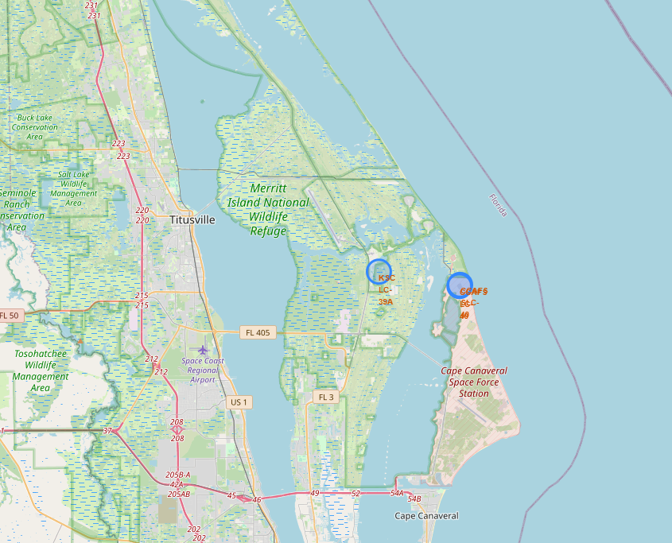
<Launch sites>
There are 3 launch sites located in Florida state and just only one stayed in California state.

Slide 37
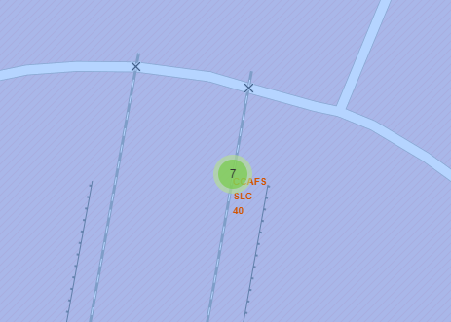
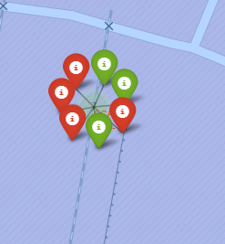
<Launch site CCAFS SLC-40 >
There are 7 flights which were launched at CCAFS SLC-40 site, and 3 of them are successful and the rest are failed.

Slide 38

Section 4

Slide 39
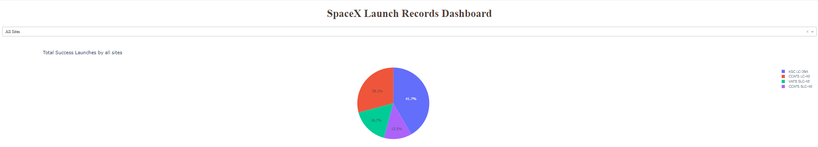
<Success Launches by all sites>
The highest success launches belonging to KSC LC-39A with 41.70%, and CCAFS SLC-40 has the lowest success rate with just only 12.50%
The success rate of CCAFS LC-40 and VAFB SLC-4E recorded 29.20% and 16.70% respectively

Slide 40
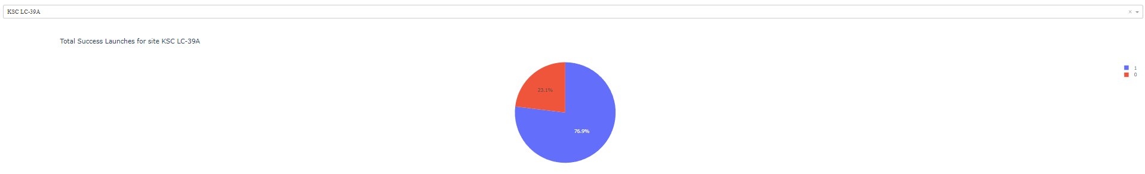
<Success ratio of KSC LC-39A site>
The success rate occupied up to 77% approximately, and the rest are uncessful flight (23.10%)

Slide 41
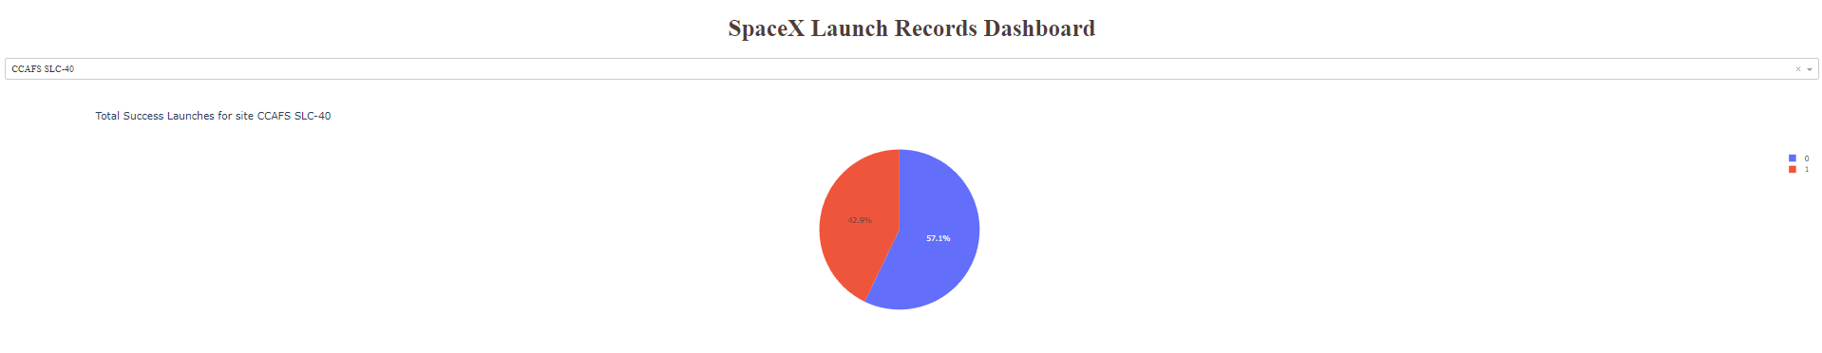
<Success ratio of CCAFS SLC-40 site>
The success rate occupied up to 57% approximately, and the rest are uncessful flight around 43%

Slide 42
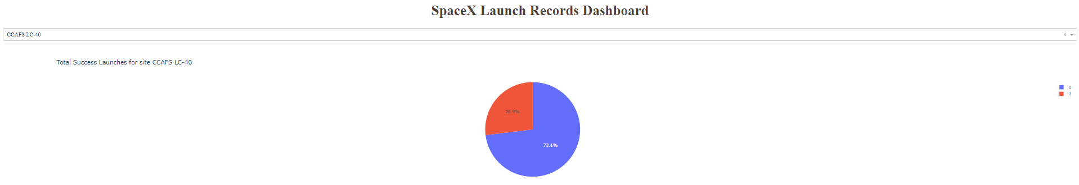
<Success ratio of CCAFS LC-40 site>
The success rate occupied up to 73% approximately, and the rest are uncessful flight around 27%

Slide 43
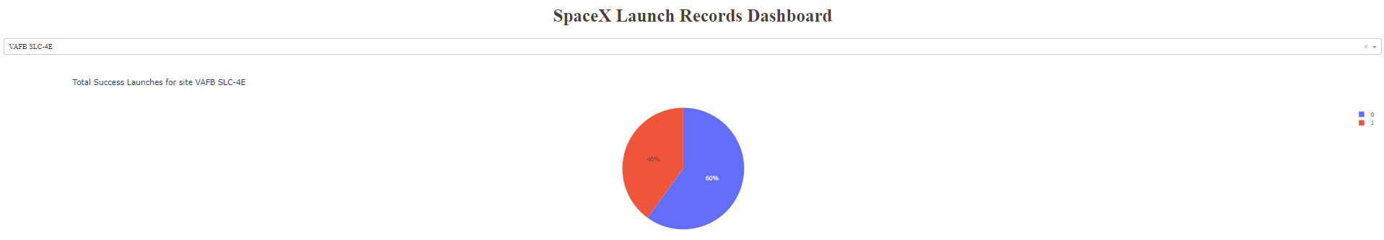
<Success ratio of CCAFS SLC-40 site>
The success rate occupied up to exact 60%, and the rest are uncessful flights 40%

Slide 44
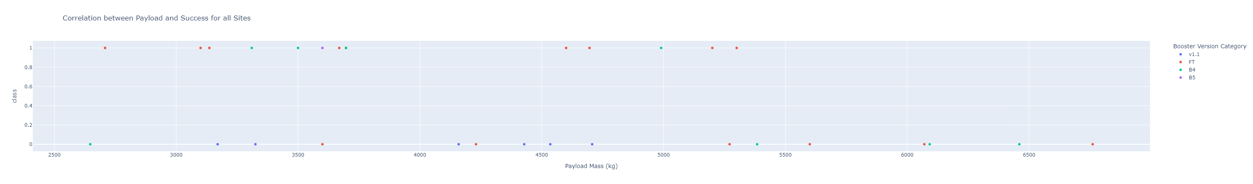
<Scatter plot of Payload vs. Launch Outcome>
Below figure shows Payload vs. Launch Outcome scatter plot for all sites, with payload range 2500-7500
Booster version FT has the highest number of succesful flight
Booster version v1.1 has the highest number of unsuccessful flight.
When the payload mass got heavier than 5500 kg, there were none successful flights recorded.

Slide 45

Section 5

Slide 46
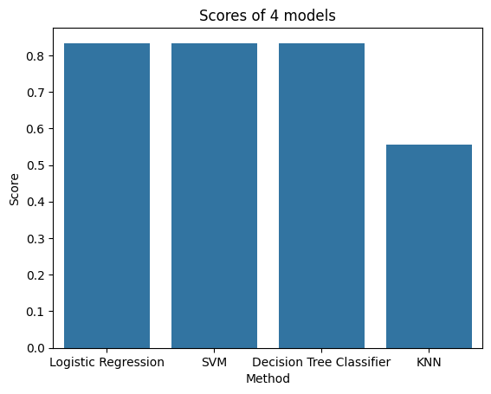
Classification Accuracy
There are 3 methods, which are Logistic Regression, SVM and Decision Tree Classifier, scoring the same and that one is the highest score on testing data.
The KNN is the method should not be considered to train and test model. Because the score offered from this method is abit more than 0.5.

Slide 47
Confusion Matrix
As mentioned from previous slide, there are 3 methods scoring the same and also that score is the highest. As a result, the confusion matrixes of the best performing model of Logistic Regression, Decision Tree Classifier and KNN are displayed in the next slide.

Slide 48
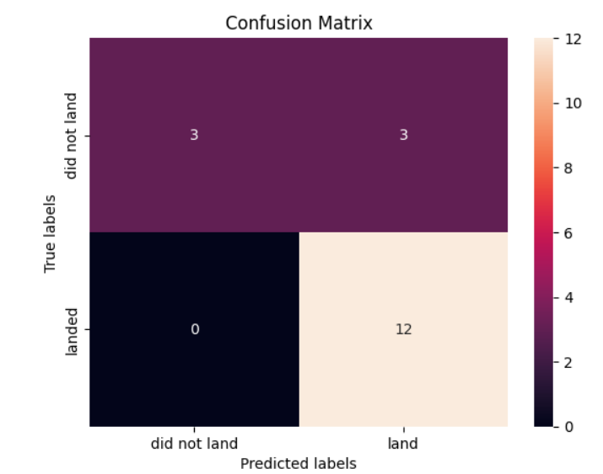
Confusion Matrix of Logistic Regression
This Logistic Regression method predict 12 launches land successfully and they did land without fails, and 3 launches land unsuccessfully and they did not land. Unfortunately, there were 3 launches this model predicted the flight land, but these flights did not land.

Slide 49
Confusion Matrix of Decision Tree Classifier
This Decision Tree Classifier method predict 12 launches land successfully and they did land without fails, and 3 launches land unsuccessfully and they did not land. Unfortunately, there were 3 launches this model predicted the flight land, but these flights did not land.

Slide 50
Confusion Matrix of Support Vector Machine
This Support Vector Machine method predict 12 launches land successfully and they did land without fails, and 3 launches land unsuccessfully and they did not land. Unfortunately, there were 3 launches this model predicted the flight land, but these flights did not land.

Slide 51
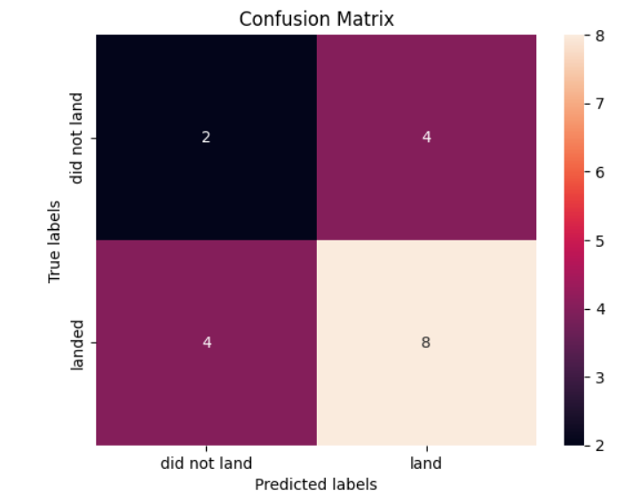
Confusion Matrix k Nearest Neighbors
This k Nearest Neighbors method predict 8 launches land successfully and they did land without fails, and 2 launches land unsuccessfully and they did not land. Unfortunately, there were 4 launches this model predicted the flight land, but they did not land; and there were also 4 launches this model predicted the flight do not land, but they did land.

Slide 52
Conclusions
Flight number and Payload has positive linear ratio with success rate. So, increasing number of flights and payload mass can be considered.
The launch rate at KSC LC-39A can be operated more often, because the success rate when launching at this rate is quite high.
The booster version FT should be chosen to utilize, because it held the best successful records.
The launch sites should be located near the costal side, because it can handle the failed flight effectively.
The method of Logistic Regression, SVM or Decision Tree Classifier is the sufficient method to train and test data.

Slide 53
Appendix
Relevant assets like Python code snippets, SQL queries, charts, Notebook outputs, or data sets that have been created during this project are attached in this presentation.

Slide 54


